Slide 1
Determining the Arbiter for Dynamic Task Allocation in Adaptive Automation Systems
Gabriella M. Hancock, Ph.D.
Assistant Professor
Director, Stress & Technology Applied Research (STAR) Laboratory
California State University, Long Beach

Slide 2
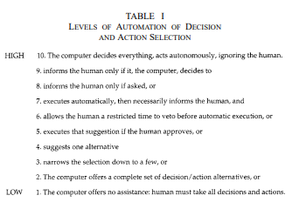
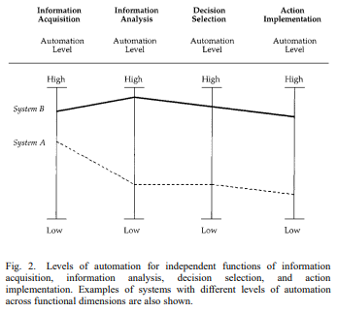
Adaptive Automation
Levels of Automation (Sheridan & Verplank, 1978)
Continuum: Fully Manual Performance (1) to Full Automation (10)
Stages of Automation (Parasuraman, Sheridan & Wickens, 2000)
Based on Information Processing Theory (Broadbent, 1958)

Slide 3
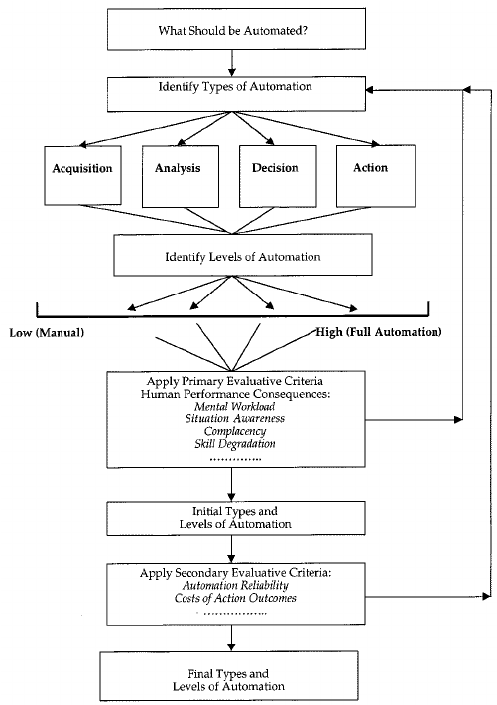
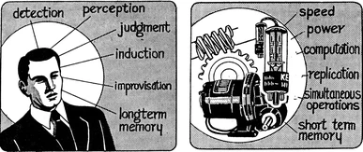
Adapting Automation
Determining Best Practice
Adaptive task aiding (Rouse, 1988)
Adaptive task allocation (Parasuraman, Mouloua & Hilburn, 1999)
Capabilities & Limitations
Fitts’s List (Fitts, 1951)
Task Demands (Miller & Parasuraman, 2003)
(Fitts, 1951, p. 7-8))
(Parasuraman, Sheridan & Wickens, 2000))

Slide 4
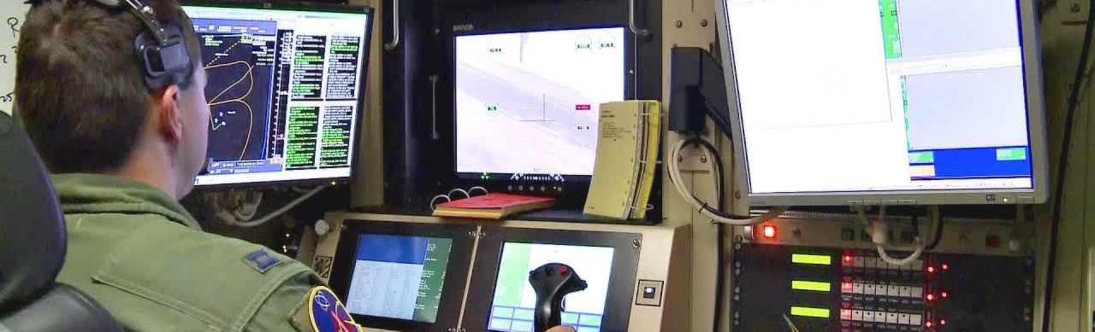
Role Shift: Agent to Monitor
Transformation of Workload
Supervisory Control
“[O]ne or more human operators are intermittently programming and continually receiving information from a computer that itself closes an autonomous control loop through artificial effectors to the controlled process or task environment” (Sheridan, 1992, p. 1)
User-centric (Kaber, Riley, Tan, & Endsley, 2001)
Dangers (Sheridan, 1988; 1992; 1997)
Out-of-the-Loop Unfamiliarity (Kaber & Endsley, 1997)
Deskilling
Notes:
Image credit: https://www.youtube.com/watch?v=_w5NGKt71k4

Slide 5
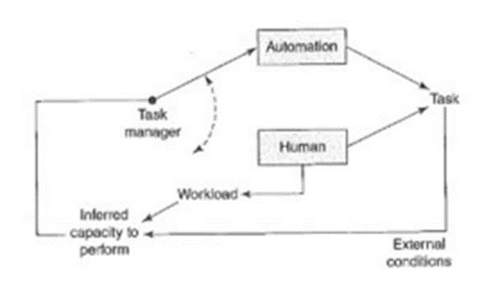
Adaptive Automation
Combats dangers with flexibility
Arbiter/Task Manager
Allocates more to auto (if WL is high)
Allocates more to operator (if workload is low)
Nature of task manager
Human – User-controlled - Adaptable Automation (Opperman, 1994)
Automation – System-controlled - Adaptive Automation (Opperman, 1994)
Combination/Cooperative (Li, Sarter, Wickens & Sebok, 2013)
Decisions regarding initiation, termination, and extent of chage are shared (Scerbo, 1996)
Dynamic function allocation (Rouse, 1977; Inagaki, 2003)
Division of labor (H + A) is changeable, flexible, and context dependent

Slide 6
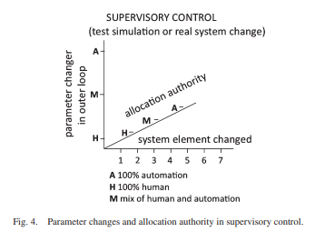
Dynamic Task Allocation
Reallocation of responsibilities based on
Tasks (or sub-tasks) to be automated (Bindewald et al., 2014)
Inference sources
Timeline of change initiation/completion
Both operator + automated system should have awareness of each other’s current
Capabilities
Performance
State
Methods of determining when changes in levels are necessary
Assessment of environment
Continuous assessment of performance
Continuous assessment of WL
(Sheridan, 2011, p. 665))

Slide 7
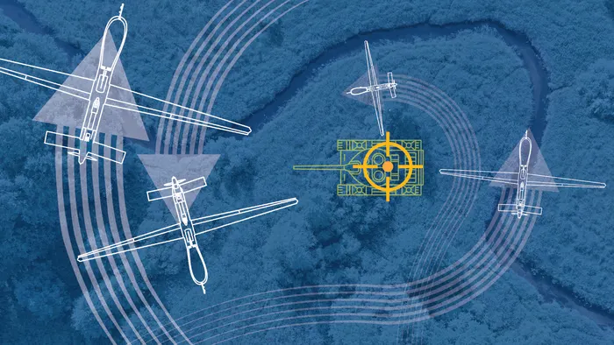
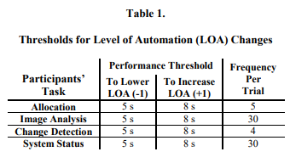
Inference Sources
Environmental Triggers
External conditions
Example
Automation senses weather front reducing visibility
Infers operator is data-limited (Norman & Bobrow, 1975)
Offloads routine scanning to automation; leaving resources for supervisory control and performance (Bonner et al., 2000)
Performance Measures
Monitor performance on one or more tasks
Thresholds of performance (Kidwell, Calhoun, Ruff & Parasuraman, 2012)
Secondary task performance (Kaber & Riley, 1999)
Reduced workload (De Visser & Parasuraman, 2011)
Increased situational awareness (Parasuraman, Cosenzo & De Visser, 2009)
(Kidwell, Calhoun, Ruff & Parasuraman, 2012, p. 430))
Notes:
Drone image credit: https://www.ft.com/content/6346dd78-322d-11ea-9703-eea0cae3f0de

Slide 8
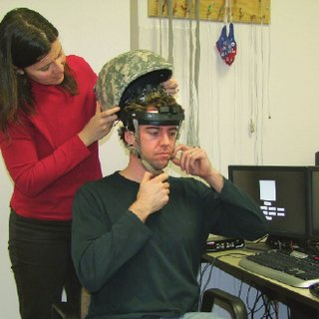
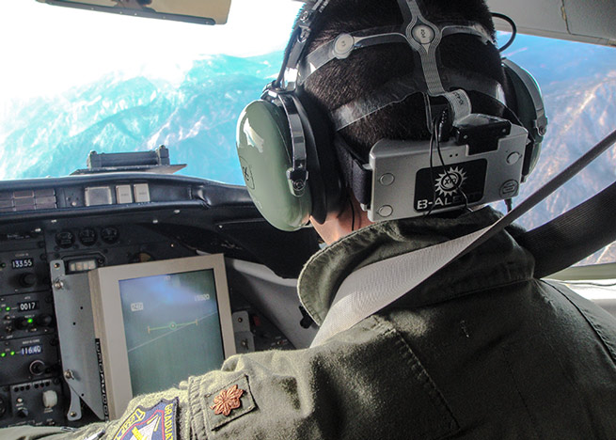
Inference Sources
Psychophysiological Assessment of Cognitive State (Byrne & Parasuraman, 1996)
Advantages
More accurate (especially when no performance changes)
Disadvantages
Signal quality (artefacts)
User acceptance issues (comfort)
Time
Needed for appropriate integration
Candidates
Electroencephalography (EEG)
Ratio of power bands (Scerbo, Freeman & Mikulka, 2010)
ERP P300 component (Prinzel et al., 2003)
Electrocardiography (EKG)
Heart rate variability (Haarmann, Boucsein & Schaefer, 2009)
Skin conductance response (Haarmann, Boucsein & Schaefer, 2009)
Eye movements (de Greef et al., 2009)
Pupil dilation
Fixation time
Results
Progressing and promising (Bailey et al., 2006; Wilson, Lambert & Russell, 2000)
Notes:
Image credit: https://www.researchgate.net/figure/An-example-of-an-electroencephalography-system-designed-to-be-worn-under-a-helmet-A_fig3_235146303
Pilot image credit: https://www.aopa.org/news-and-media/all-news/2013/december/12/eegs-find-mental-sweet-spot-of-pilots

Slide 9
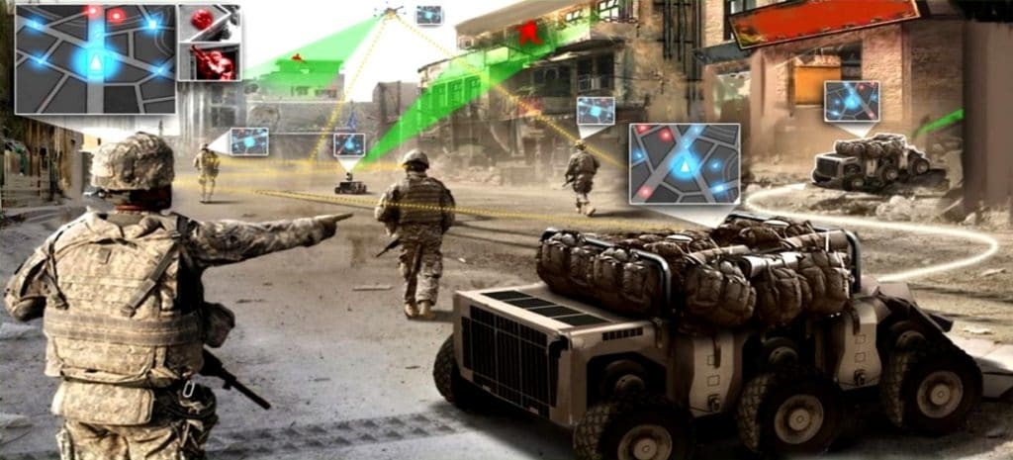
Ultimate Arbiter: Human, Machine, Cooperative?
More Research Necessary
Current Stance: Adaptable Automation
Human (Cautiously)
Overconfidence bias
Illusory superiority
Future Stance: Adaptive Automation
Automation with 3 Inference Sources
Humans = resource and structurally-limited
Automation not thus handicapped
Operations will become sufficiently complex that only automation can fully collect, integrate, and interpret data and act in a timely fashion (and see Arciszewski, de Greef & van Delft, 2009)
Notes:
Cockpit image credit: https://thenextweb.com/podium/2019/05/30/why-pilots-are-safe-from-automation-for-now/
Augmented reality image credit: https://mronline.org/2018/02/20/the-u-s-military-will-have-more-robots-than-humans-by-2025/

Slide 10
Thank You & Questions
GABRIELLA HANCOCK, Ph.D.
Assistant Professor
Psychology Department
California State University Long Beach
e: Gabriella.Hancock@csulb.edu
p: (562) 985 - 4856

Slide 11
References
Arciszewski, H. F., De Greef, T. E., & Van Delft, J. H. (2009). Adaptive automation in a naval combat management system. IEEE Transactions on Systems, Man, and Cybernetics-Part A: Systems and Humans, 39(6), 1188-1199.
Bailey, N. R., Scerbo, M. W., Freeman, F. G., Mikulka, P. J., & Scott, L. A. (2006). Comparison of a brain-based adaptive system and a manual adaptable system for invoking automation. Human Factors, 48(4), 693-709.
Bindewald, J.M., Miller, M.E., & Peterson, G.L. (2014). A function-to-task process model for adaptive automation system design. International Journal of Human-Computer Studies, 72(12), 822-834.
Bonner, M., Taylor, R., Fletcher, K., & Miller, C. (2000, October). Adaptive automation and decision aiding in the military fast jet domain. In Proceedings of the conference on Human Performance, Situation Awareness and Automation: User centered design for the new Millennium (pp. 154-159).
Broadbent, D.E. (1958). Perception and communication. London, UK: Pergamon.
Byrne, E.A., & Parasuraman, R. (1996). Psychophysiology and adaptive automation. Biological Psychology, 42(3), 249-268.
de Greef, T., Lafeber, H., van Oostendorp, H., & Lindenberg, J. (2009, July). Eye movement as indicators of mental workload to trigger adaptive automation. In International Conference on Foundations of Augmented Cognition (pp. 219-228). Springer, Berlin, Heidelberg.
De Visser, E., & Parasuraman, R. (2011). Adaptive aiding in human-robot teaming: Effects of imperfect automation on performance, trust, and workload. Journal of Cognitive Engineering and Decision Making, 5(2), 209-231.
Fitts, P. M. (1951). Human engineering for an effective air-navigation and traffic-control system. National Research Council, Washington, DC.
Haarmann, A., Boucsein, W., & Schaefer, F. (2009). Combining electrodermal responses and cardiovascular measures for probing adaptive automation during simulated flight. Applied Ergonomics, 40(6), 1026-1040.
Inagaki, T. (2003). Adaptive automation: Sharing and trading of control. Handbook of cognitive task design, 8, 147-169.

Slide 12
References
Kaber, D. B., & Endsley, M. R. (1997, October). The combined effect of level of automation and adaptive automation on human performance with complex, dynamic control systems. In Proceedings of the Human Factors and Ergonomics Society Annual Meeting (Vol. 41, No. 1, pp. 205-209). Sage CA: Los Angeles, CA: SAGE Publications.
Kaber, D.B., & Riley, J.M. (1999). Adaptive automation of a dynamic control task based on secondary task workload measurement. International Journal of Cognitive Ergonomics, 3(3), 169-187.
Kaber, D. B., Riley, J.M., Tan, K-W., & Endsley, M.R. (2001). On the design of adaptive automation for complex systems. International Journal of Cognitive Ergonomics, 5(1), 37-57.
Kidwell, B., Calhoun, G. L., Ruff, H. A., & Parasuraman, R. (2012, September). Adaptable and adaptive automation for supervisory control of multiple autonomous vehicles. In Proceedings of the human factors and Ergonomics society annual meeting (Vol. 56, No. 1, pp. 428-432). Sage CA: Los Angeles, CA: SAGE Publications.
Li, H., Sarter, N., Wickens, C., & Sebok, A. (2013, September). Supporting Human-Automation Collaboration Through Dynamic Function Allocation: The Case of Space Teleoperation. In Proceedings of the Human Factors and Ergonomics Society Annual Meeting (Vol. 57, No. 1, pp. 359-363). Sage CA: Los Angeles, CA: SAGE Publications.
Miller, C. A., & Parasuraman, R. (2003, October). Beyond levels of automation: An architecture for more flexible human-automation collaboration. In Proceedings of the Human Factors and Ergonomics Society Annual Meeting (Vol. 47, No. 1, pp. 182-186). Sage CA: Los Angeles, CA: SAGE Publications.
Norman, D. A., & Bobrow, D. G. (1975). On data-limited and resource-limited processes. Cognitive Psychology, 7(1), 44-64.
Opperman, R. (1994). Adaptive user support. Hillsdale, NJ: Erlbaum.
Parasuraman, R., Cosenzo, K.A., & De Visser, E. (2009). Adaptive automation for human supervision of multiple uninhabited vehicles: Effects on change detection, situation awareness, and mental workload. Military Psychology, 21, 270-297.
Parasuraman, R., Mouloua, M., & Hilburn, B. (1999). Adaptive aiding and adaptive task allocation enhance human-machine interaction. In M. W. Scerbo & M. Mouloua (Eds.), Automation technology and human performance: Current research and trends (pp. 119–123). Mahwah, NJ: Erlbaum.

Slide 13
References
Parasuraman, R., Sheridan, T. B., & Wickens, C. D. (2000). A model for types and levels of human interaction with automation. IEEE Transactions on systems, man, and cybernetics-Part A: Systems and Humans, 30(3), 286-297.
Prinzel, L.J. III, Freeman, F.G., Scerbo, M.W., Mikulka, P.J., & Pope, A.T. (2003). Effects of a psychophysiological system for adaptive automation on performance, workload, and the event-related potential P300 component. Human Factors, 45(4), 601-613.
Rouse, W. B. (1977). Human-computer interaction in multitask situations. IEEE Transactions on Systems, Man, and Cybernetics, 7(5), 384-392.
Rouse, W. B. (1988). Adaptive aiding for human/computer control. Human Factors, 30(4), 431-443.
Scerbo, M.W., (1996). Theoretical perspectives on adaptive automation. In R. Parasuraman & M. Mouloua (Eds.), Automation and human performance: Theory and applications (pp.37-63). Hillsdale, NJ: Erlbaum.
Scerbo, M.W., Freeman, F.G., & Mikulka, P.J. (2010). A brain-based system for adaptive automation. Theoretical Issues in Ergonomics Science, 4, 200-219.
Sheridan, T. B. (1988). Task allocation and supervisory control. In Handbook of human-computer interaction (pp. 159-173). North-Holland.
Sheridan, T. B. (1992). Telerobotics, automation, and human supervisory control. MIT press.
Sheridan, T. B. (1997). Task analysis, task allocation and supervisory control. In Handbook of human-computer interaction (pp. 87-105). North-Holland.
Sheridan, T. B. (2011). Adaptive automation, level of automation, allocation authority, supervisory control, and adaptive control: Distinctions and modes of adaptation. IEEE Transactions on Systems, Man, and Cybernetics-Part A: Systems and Humans, 41(4), 662-667.
Sheridan, T.B. &Verplank, W.L. (1978). Human and computer control of undersea teleoperators. MIT Man-Machine Systems Laboratory, Cambridge, MA. Technical Report.
Wilson, G. F., Lambert, J. D., & Russell, C. A. (2000, July). Performance enhancement with real-time physiologically controlled adaptive aiding. In Proceedings of the human factors and ergonomics society annual meeting (Vol. 44, No. 13, pp. 61-64). Sage CA: Los Angeles, CA: SAGE Publications.

