Slide 1
Fatigue Detection and Prediction Using Wearable Technology
Presenter: Rachel Sides
Project Lead: Alex Kniffin
Naval Surface Warfare Center – Dahlgren Division
V13 Human Systems and Automation Branch

Slide 2
Problem Statement
Constant vigilance in Navy watchstanding leads to cognitive fatigue
Time consuming data collection
Non-real-time task analysis
Need a fast, quantitative, real-time method to detect and predict cognitive fatigue
Unreliable self-reports

Slide 3
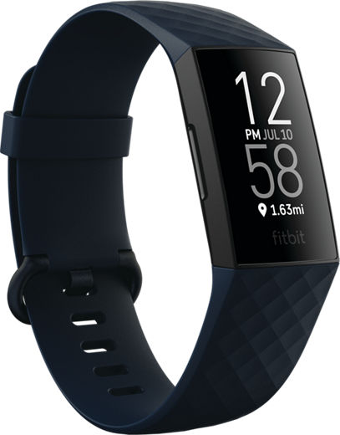
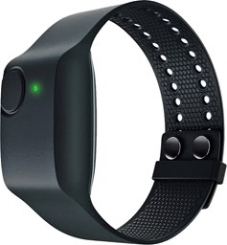
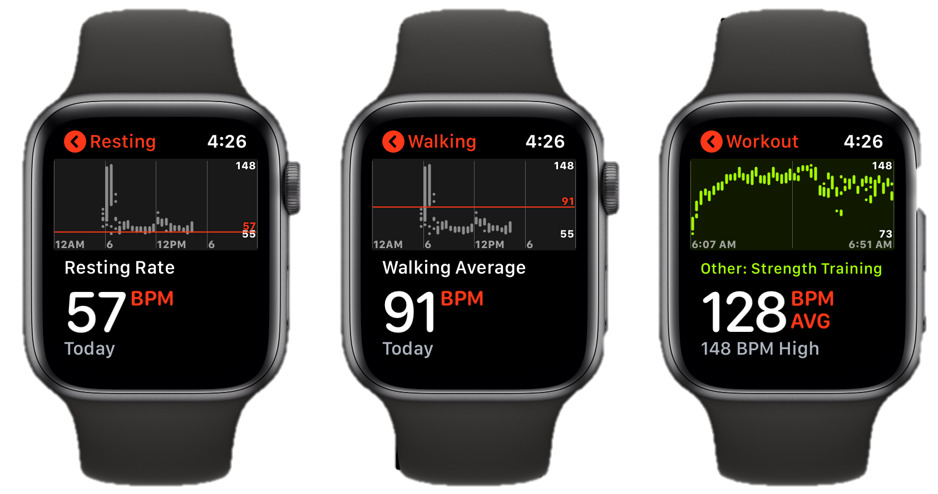
Proposed Solution
Wearable Physiology Monitor
Machine Learning (ML) Algorithm
Real-time Fatigue Detection/ Prediction
Commercial-Off-The-Shelf physiology monitors are readily available

Slide 4
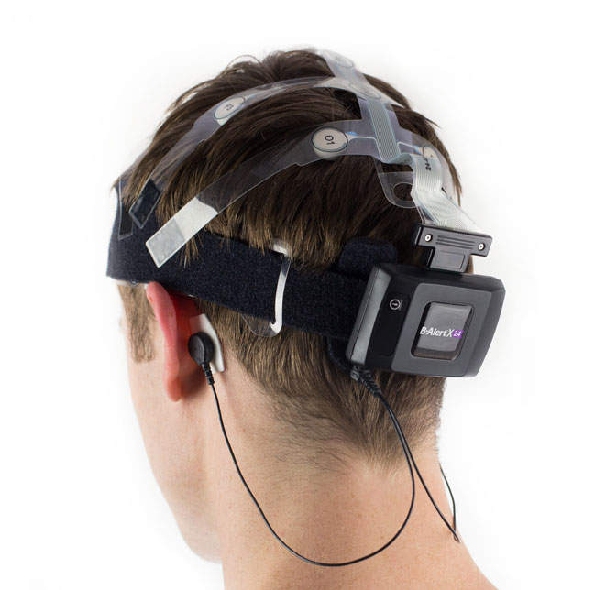
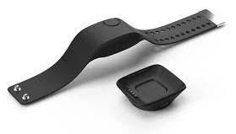
Wearable Sensors
Central Nervous System
Brains of the operation
Electroencephalography (EEG)
Gold standard for detecting cognitive fatigue
Peripheral Nervous System
Boots on the ground
Empatica E4®
Electro-Dermal Activity (sweat)
Skin Temperature
Blood Pulse Volume
Inter-Beat Interval
Heart Rate
Rest and Digest
Parasympathetic
Slows heart beat
Dilates blood vessels
Sympathetic
Accelerates heart beat
Constricts blood vessels
Stimulates sweat glands
Fight
or
Flight
Empatica is a registered trademark of Empatica S.R.L, LLC Milano, Italy
Notes:
Traditionally, cognitive fatigue is monitored through signals from the central nervous system. However, the technology to capture these signals, EEG for example, are usually quite finicky and not suitable for the naval operational environment.
We chose to focus on the peripheral nervous system. To capture these changes, we used the Empatica E4 wrist monitor.

Slide 5
What is Cognitive Fatigue?
Subjective
Objective
“Lack of mental energy perceived by the individual to interfere with usual and desired activities” –Multiple Sclerosis Council for Clinical Practice¹
“Performance decrement over time” –DeLuca et al²
Over 100 years of study has shown that self-reported fatigue does not correlate with objectively measured fatigue^{3,4}
Notes:
Successful attempts at objective measurement of cognitive fatigue have focused on decreased behavioral performance in tasks requiring sustained mental effort. This approach is similar to that typically thought of in the motor fatigue literature, where fatigue has been defined as a failure to maintain a required force or output of power during sustained or repeated muscle contraction. There is indeed considerable support for such an objective assessment of cognitive fatigue in clinical populations (see DeLuca, 2007 for a review)

Slide 6
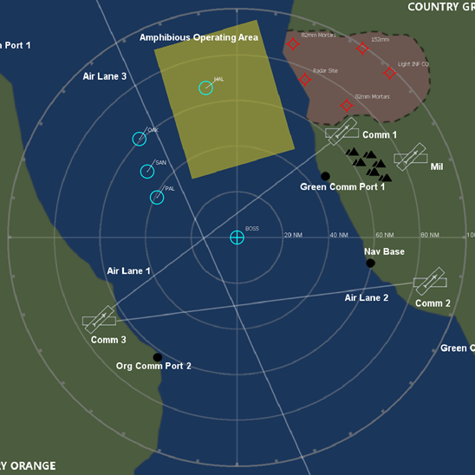
Lessons Learned in Year 1
First year results
Fatigue occurred
Researcher observed
Subjective reports
Physiological data
Did not correlate with subjective reports
Second year modifications
Focus on error rate, not subjective fatigue
More advanced machine learning methods
EEG hardware upgraded
Protocol simplified
Closely follow validated Mackworth Clock Task
First Year Protocol
Second Year Protocol
Notes:
In the first year, we tried to rely on the subjectively measured fatigue, but were facing the same barriers where it just would not correlate with the objective data that was being reported by the E4 device. So in the second year, we shifted our fatigue definition to be based on error rates rather than subjective reports.
First year protocol had too much task switching and was too similar to a video game. Participant fatigue was sporadic throughout the protocol and difficult to analyze

Slide 7
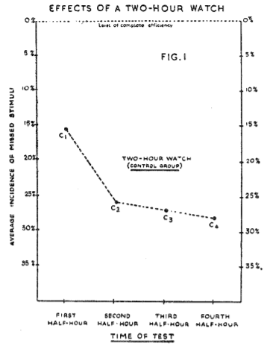
Mackworth Clock Experiment (1948)⁵
Real-World, Naval Origin
WWII, Royal Air Force
Determine optimal watch length for radar operators
Mimicked features of watch-standing
Difficult to perceive visual signals
Disregard unimportant but similar signals
No performance gauge
Initiated the study of the “Vigilance Decrement”
Notes:
This study was the first of many to show that vigilance decreases within the first 30 minutes of a task, which came to be defined as the vigilance decrement.
Vigilance – “a psychological readiness to perceive and respond, a process which, unlike attention, need not necessarily be consciously experienced”

Slide 8
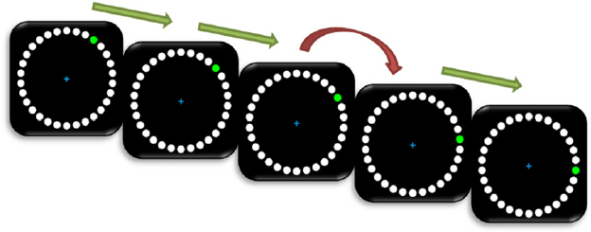
Mackworth Clock
No visual placeholders
Accurately identify discontinuities
Two conditions:
Single dot: fatigue, classic vigilance decrement
Double dot: overloaded
Notes:
Participants are asked to correctly identify when the colored dot moves two spaces rather than one by pressing a key. For our specific set up, the white placeholders were not visible to the participants.

Slide 9
Date collection and Preliminary results
Experiment Part I:

Slide 10
Test Methods and Timing
B-Alert EEG | MUSE 2® EEG
Baseline for cognitive state classification High Engagement Low Engagement Distracted Sleep Onset | Touchless for pandemic response Baseline performed for consistency No classification
Devices & Brief
EEG
E4®
EEG Baseline
3 Choice VT
Eyes Open VT
Eyes Closed VT
Begin Data Collection
Demographics
ADACL Survey
Mackworth
30 minutes
Single dot
ADACL Survey
Repeat 3x
Mackworth
30 minutes
Double dot
ADACL Survey
3
Empatica is a registered trademark of Empatica S.R.L, LLC Milano, Italy
MUSE 2 is a registered trademark of InteraXon Inc., Toronto, ON, Canada
Notes:
VT – Vigilance Task
ADACL – Activation/Deactivation Adjective Checklist: subjective cognitive state assessment

Slide 11
Preliminary Data and Improvements Over Year One
Weighted Accuracy (%) | 100
 | 80
 | 60
 | 40
 | 20
 | 0
30 participants
Ages 22-54
Mean = 32.9
Standard Deviation = 9.9
70% Male
EEG data acquisition improved, slightly
Skin Temperature (°C) | 33.0
 | 32.5
 | 32.0
 | 31.5
 | 31.0
0 | 1000 | 2000 | 3000 | 4000 | 5000 | 6000 | 7000
Elapsed Time (sec)
Off-the-shelf classification algorithm was black box
Additional data analysis required for use of raw signals – future interest
Peripheral Nervous System data correlated with accuracy
Subjective reports were inconsistent and not analyzed
Notes:
93% right handed – E4 data collection has shown differences depending on which hand it is worn on.
Additional data was collected from active-duty participants from Aegis Training and Readiness Center at Dahlgren, however that data set has not yet been analyzed.

Slide 12
Machine Learning
Experiment Part II:

Slide 13
Machine Learning
Operator fatigue/accuracy:
2D Convolutional Neural Network (CNN) regression model
Loss function: mean absolute error (MAE)
Cognitive load/task difficulty:
2D CNN classifier model
Loss function: binary cross-entropy function
PNS Signal Input
Data Cleaning & Labeling
CNN-based feature extraction
Model Results
Task Accuracy Prediction
Task Difficulty Prediction
Notes:
MAE not Mean Square Error to minimize the effect of outliers on the training
PNS – peripheral nervous system

Slide 14
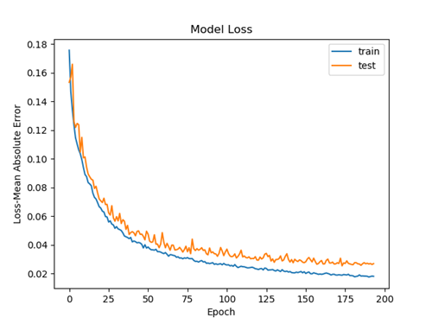
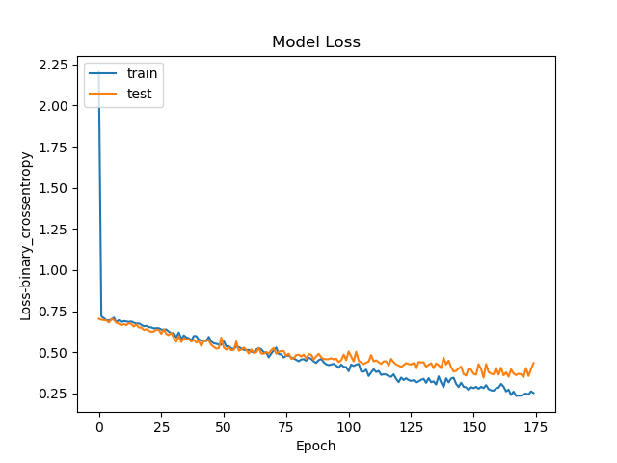
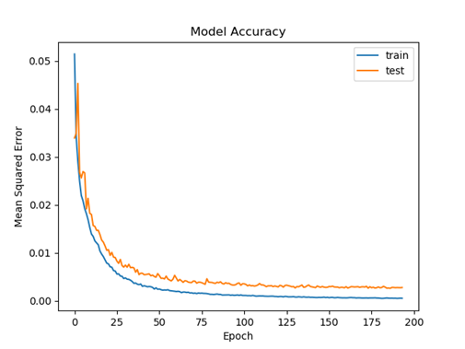
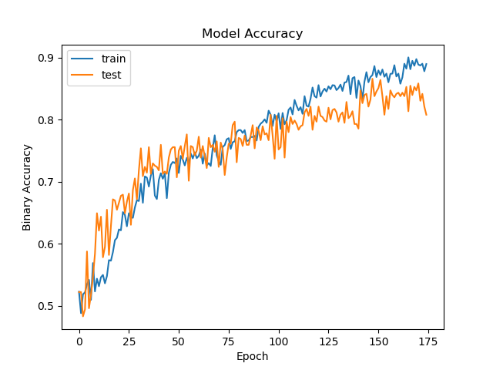
Results: Machine Learning Model Accuracy
Determined Task-Accuracy within MAE of 2.5%
92% of vigilance decrements exceeded 5% Task-Accuracy
Task-Type identification was 86.5% accurate
Model Loss
Model Loss
–– Test
–– Train
–– Test
–– Train
Loss – Mean Absolute Error
Loss – Binary Cross Entropy
Epoch
Epoch
Model Accuracy
Model Accuracy
–– Test
–– Train
–– Test
–– Train
Mean Squared Error
Binary Accuracy
Epoch
Epoch
Notes:
Regression:
Model is well fit
Model was able to detect when task accuracy degraded based on physiological inputs
Performance decrement: 92% between 22.12-1.43*12.0 = [4.96, 46.08)
Classification:
Symptoms of overfitting in the last 20 epochs
Model was able to detect when participants were overloaded
Limitations:
Small sample size

Slide 15
Conclusions and Potential Impacts
Cognitive fatigue during a vigilance task can be detected from peripheral nervous system signals
Can identify critical points in Human Factor Scenarios
Can prevent fatal errors and improve safety for our fleet and nation
Level of cognitive load can be detected from PNS signals
Can inform task analyses and improve personnel allocation
Cost savings from labor requirement reductions
Commercial-Off-The-Shelf physiology monitors are readily available and much easier to use than CNS monitors
Reduces barrier to technology adoption
Improved speed to fleet for technology
Notes:
ATRC – Aegis Training and Readiness Center at Dahlgren
PNS – peripheral nervous system
CNS – central nervous system

Slide 16
Next Steps
Further investigations with more dynamic scenarios
Non-working memory tasks
Physical fatigue
Environmental factors
Adapt ML algorithm for real-time prediction
Analyze EEG data sets
Analyze active-duty data set collected from ATRC
Notes:
ATRC – Aegis Training and Readiness Center at Dahlgren

Slide 17
Questions?

Slide 18
References
Paralyzed Veterans of America. Fatigue and multiple sclerosis: evidenced-based management strategies for fatigue in multiple sclerosis. Washington (DC): Multiple Sclerosis Council for Clinical Practice Guidelines; 1998.
DeLuca J., Genova H. M., Capili E. J., & Wylie G. R. (2009). Functional neuroimaging of fatigue. Physical Medicine and Rehabilitation Clinics of North America, 20, 325-337
DeLuca J. Fatigue: its definition, its study and its future. In: DeLuca J, editor.
Mosso A. Fatigue. London: Swan Sonnenschein and Co; 1904.
Mackworth, N. H. (1948). The breakdown of vigilance during prolonged visual search. Quarterly Journal of Experimental Psychology, 1, 6-21.
Fatigue as a window to the brain. Cambridge (MA): MIT Press; 2005. p. 319–25.
Paas, F. G. & Adam, J. J. (1991). Human information processing during physical exercise. Ergonomics, 34, 1385–1397.
McMorris, T. & Keen, P. (1994). Effect of exercise on simple reaction times of recreational athletes. Perceptual and Motor Skills, 78(1), 123–130.
Brisswalter, J., Durand, M., Delignieres, D., & Legros, P. (1995). Optimal and non-optimal demand in a dual task of pedaling and simple reaction time: effects on energy expenditure and cognitive performance. Journal of Human Movement Studies, 29(1), 15-34.
Hogervorst, E., Riedel, W., Jeukendrup, A., & Jolles, J. (1996). Cognitive performance after strenuous physical exercise. Perceptual and Motor Skills, 83(2), 479-488.
Cian, C., Barraud, P. A., Melin, B., & Raphel, C. (2001). Effects of fluid ingestion on cognitive function after heat stress or exercise-induced dehydration. International Journal of Psychophysiology, 42, 243–251.
Cian, C., Koulmannn, N., Barraud, P. A., Raphel, C., Jimenez, C., & Melin, B. (2000). Influences of variations in body hydration on cognitive function: effects of hyper-hydration, heat stress, and exercise induced dehydration. Journal of Psychophysiology, 14, 29–36.
Tomporowski, P. D., Beasman, K., Ganio, M. S., & Cureton, K. (2007). Effects of dehydration and fluid ingestion on cognition. International Journal of Sports Medicine, 28, 891-96.
Chaudhuri, A. & Behan, P. (2000). Fatigue and basal ganglia. Journal of Neurological Science, 179(Suppl 1–2), 34–42.
Chaudhuri, A. & Behan, P. (2004). Fatigue in neurological populations. Lancet, 363, 978–88.
Hockey, G. R. J., & Wietoff, M. (1993). Cognitive fatigue in complex decision-making. Advanced Space Biology and Medicine, 3, 139–150.

