Slide 2
DARPA Characteristics
Revolutionary Change
High Risk Tolerance
Program Manager Centric
Just-In-Time Topic Development
$3B Funding Agency
SBIR Program
3.2% of all extramural RDT&E
FY20 - $91.2M
STTR Program
.45% of all extramural RDT&E
FY20 – $13.2M

Slide 3
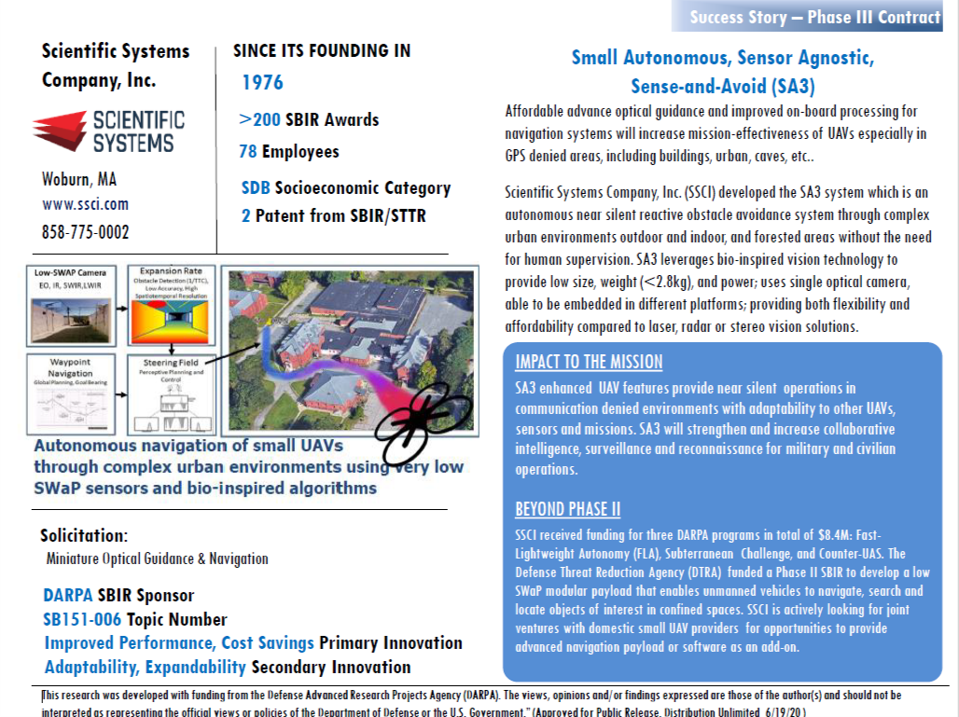
DARPA Success Stories
Find More Success Stories at: https://www.darpa.mil/work-with-us/sbir-sttr-success-reports

Slide 4
DARPA Technical Offices
BTO
DSO
I2O
MTO
STO
TTO
BIOLOGICAL TECHNOLOGIES OFFICE
DEFENSE SCIENCES OFFICE
INFORMATION INNOVATION OFFICE
MICROSYSTEMS TECHNOLOGY OFFICE
STRATEGIC TECHNOLOGY OFFICE
TACTICAL TECHNOLOGY OFFICE
Biology for security
Outpacing infectious disease
Neurotechnology
Gene editing & synthetic biology
Frontiers in math, computation, & design
Limits of sensing & sensors
Complex social systems
Anticipating surprise
Symbiosis: partner with machines
Analytics: understand the world
Cyber: deter cyber attack
Electronics: drive solutions for DoD access and infrastructure
Spectrum: focus on usability of highly-adaptive systems
Sensors: enable high-end capabilities to proliferate into the field
Lethality: resilient killchains over invulnerable systems
Surprise: heterogeneity over uniformity
Continuous speed: agility and adaptability over performance
Enterprise disruption: platforms, systems, and technologies that enable new warfighting constructs
Crosscutting themes
Eliminate high-value assets
Exploit cross-domain seams
Enable decision-making asymmetry

Slide 5
SBIR/STTR Program Broad Agency Announcement (BAA)
DARPA issues an out-of-cycle BAA for its SBIR/STTR Program
Topics are released under this BAA as they are approved
This ensures SBIR/STTR funding opportunities are aligned with DARPA’s primary technology programs and avails small businesses the benefits associated with integration into established program communities.
Note – Other DoD agencies only issue SBIR/STTR topics during three pre-determined announcements.
Topics are released as Phase I, Direct to Phase II (DP2) or both
Companies must propose to specific topic(s) before BAA close
Out-of-cycle BAA allows DARPA SBIRs/STTRs to be more responsive to Tech Office needs and funding streams.
Allows Program Managers to cast a broad net for potential solutions as DP2 allows DARPA to make a Phase II SBIR award to a small business concern, without regard to whether the firm was provided Phase I award.
Proposals are evaluated based on three (3) criteria: (1) Technical Merit and Innovation of Proposed Approach, (2) Qualification of Key Personnel and Facilities, and (3) Potential for Commercialization.
5

Slide 6
SBIR/STTR Program Structure
Phase | SBA SBIR/STTR Program |  | DARPA SBIR/STTR Program
Phase I (optional) | $256,580 cap (12 months) Feasibility Study |  | $225,000 (~10 months) Feasibility Study
Phase II* | $1,710,531 cap (24-36 months) Adoptions/Co-funds Continued Research and Prototype |  | $1,500,000 (24-36 months) Adoptions/Co-funds Continued Research and Prototype
Phase II Enhancement | $1:$1 Match (up to 12 months) |  | $1:$1 Match (up to 12 months) Up to $500K
Phase III | No time limit No SBIR funds |  | No time limit No SBIR funds
*Phase II values can exceed these numbers if funds are available and by using a simple waiver process.
Note: There is no cap on the amount of non-SBIR/STTR funding that can be applied to a SBIR/STTR.
6

Slide 7
Transition and Commercialization Support Program (TCSP)
Advanced technology with no customers is technology sitting on a shelf doing nothing!
The TCSP works with small businesses to ensure that DARPA SBIR/STTR technology investment has impact within the DoD Acquisition Chain and US Technology Community
Service Labs & SBIR Programs
TCSP supports DARPA SBIR/STTR performers by:
DARPA PMs and Mainline DARPA Programs
COCOM J7 & J8 Directorates
Promoting match making:
Develop listings of potential end-users, collaborators, partners and funding sources
Assist with articulation of business value proposition and marketing posture
Facilitate discussions for technologies of interest between companies and potential funding sources
Host Meet & Greet events for direct interactions with government agencies & primes
Documenting and tracking transition results and successes
Providing Fact Sheets on topics such as responding to BAAs; alternative funding options
SBIR/STTR Performers
TCSP
Large Corporations (GE, Dow Chemical, etc.)
–
Venture & Angel Capital
Other Government Agencies (IC, DOE)
Major Defense Contractors (LMCO, Raytheon, etc.)
TCSP works with Phase II awardees across all 6 DARPA Tech Offices (~200 active projects)
TCSP costs covered by DARPA SBPO

Slide 8
CoVid-19 Response
Current SBIR/STTR CoVid Efforts:
De Novo DNA Inc.
DARPA small business performer De Novo DNA Inc.’s high-throughput multiplexed SARS-CoV-2 diagnostic assay has been successfully implemented in AFRL experiments, moving towards validation with clinical samples. This assay and its accompanying analytics are reported to be easier to use and more efficient than existing systems, easing widespread deployment. The assay is capable of testing up to 19,200 patient samples simultaneously in under 24 hours.
Upcoming SBIR/STTR CoVid Awards:
DARPA will be making five awards to SBCs to continue the fight against CoVid-19. Below are the five projects selected for funding in collaboration with the OSD SBIR/STTR Office.
Influit Energy - Low Cost Ventilator, 12 month PoP, $1.7M
Inkbit - High Volume Additive Manufacturing of PPE, 12 month PoP, $1.7M
Autonomous Therapeutics - Pan-coronavirus countermeasures, 12 month PoP, $1.7M
Nanohmics - Immunochromatographic Quantum Dot (IC-Qdot) based testing, 12 month PoP $1.7M
ProbiusDX - Robust Point-of-Care test kits, 12 month PoP, $1.7M

Slide 9
New Initiatives: 2017 - Present
Utilization of Direct to Phase II Authority
Implementation of year long DARPA BAA; Topics released in “Just in Time” basis
Greater emphasis on Cross Agency Awards, aka Adoptions
Utilization of raised award ceilings for Phase I and Phase II Awards
Elimination of Phase I Options; Option work is now included as part of the Phase I award

Slide 10
Future Planned Initiatives
Contracting
DARPA is in the process of moving 50% of all contracting to DARPA Contract Management Office (CMO) to decrease time to award
Timing of BAA Release
DARPA Plans to release overarching SBIR/STTR earlier in the CY to maximize topic release

Slide 11
Doing Business With DARPA
Do Your Research - Become familiar with the challenges and opportunities of National Security.
Visit www.grants.gov or www.beta.sam.gov to view DARPA Broad Agency Announcements (BAAs), Research Announcement (RAs), and Requests for Proposals (RFPs).
Visit https://www.dodsbirsttr.mil to view DoD SBIR and STTR Program Announcements.
Contact a DARPA Program Manager (PM) about your idea prior to submitting a white paper or proposal to gain insight into the general need for the type of effort. PMs are the key to working with DARPA.
http://www.darpa.mil/about-us/about-darpa

Slide 12
DARPA Small Business Programs Office (SBPO)
http://www.darpa.mil/work-with-us/for-small-businesses
Jennifer Thabet
Program Director
Small Business Support Team
(703) 526-4170
sbir@darpa.mil
www.darpa.mil
12

