Slide 1
DEPARTMENT OF THE NAVY
SMALL BUSINESS INNOVATION RESEARCH (SBIR)
SMALL BUSINESS TECHNOLOGY TRANSFER (STTR)
Mr. Robert L. Smith
Director, DON SBIR/STTR & Special Programs
robert.l.smith6@navy.mil
DISTRIBUTION STATEMENT A. Approved for public release: distribution unlimited.

Slide 2
Federal SBIR/STTR Org Chart
SBA
DoD
HHS
NASA
DOE
NSF
USDA
EPA
DHS
ED
DOC
DOT
Army
Navy
Air Force
MDA
DARPA
OSD
DHA
SOCOM
CBD
DTRA
DLA
DMEA
NGA
NAVAIR
NAVSEA
ONR
NAVWAR
SSP
NAVSUP
MCSC
NAVFAC
DISTRIBUTION STATEMENT A. Approved for public release: distribution unlimited.

Slide 3
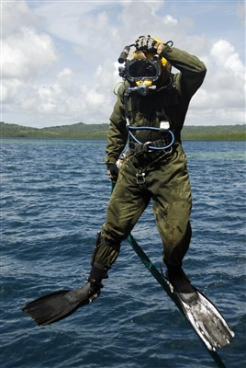
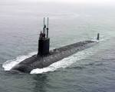
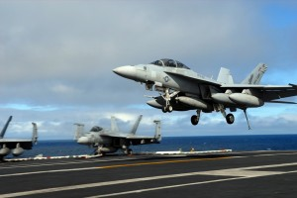
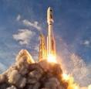
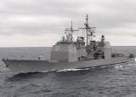
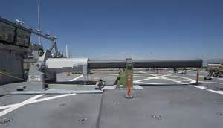
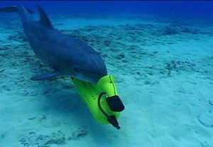
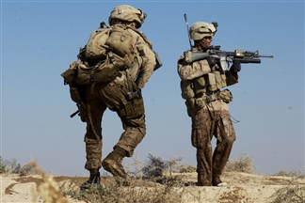
What is Part of DON SBIR/STTR?
We Need YOUR Solutions
3
DISTRIBUTION STATEMENT A. Approved for public release: distribution unlimited.

Slide 4
DON Needs. . . Topics
Topics are the Navy’s way to identify needs to which small businesses submit proposed (innovative) solutions
Topics:
Start the whole SBIR/STTR process
Are developed by the Government, not industry
Are traditionally narrow in scope but can be broad (to solicit a range of solutions)
Must –
Seek a solution to a defense need
Allow proposing SBCs significant flexibility in formulating their approach
Identify commercialization potential
Not be duplicative
Be clearly written and provide sufficient detail
DISTRIBUTION STATEMENT A. Approved for public release: distribution unlimited.

Slide 5
Near-Term Department of Navy SBIR/STTR Opportunities Eight SYSCOMs participate throughout the year
$200M+ in Funding Opportunities – Upcoming BAAs
BAA | Pre-Release | Open | Close | Focus Areas
FY20.3/C | 8/25/2020 | 9/23/2020 | 10/22/2020 | Machine Learning/AI, Autonomy, Directed Energy, Microelectronics, Networked C3, Warfighting Technologies
FY21.1/A | 11/24/2020 | 1/6/2021 | 2/10/2021 | Aligned with NDS priorities and DON needs
Seeking innovative solutions to support our warfighters
DISTRIBUTION STATEMENT A. Approved for public release: distribution unlimited.

Slide 6
Transition Assistance SBIR/STTR Transition Program (STP)
11-month Navy-specific program (NavySTP.com)
Provides services to assist with transition of technologies through:
Business mentoring
Education
Networking
Services provided by Business Consultants and Market Researchers
Mentoring on Government/prime contractor relationships
Conducting market research appropriate to transition targets
Identifying leads for potential transition opportunities
Promoting technologies on the Virtual Transition Marketplace (VTM) − an online, searchable showcase accessible to Government and private sector
Assisting with exhibiting at Forum for SBIR/STTR Transition (FST) and Focused Technology Events
DISTRIBUTION STATEMENT A. Approved for public release: distribution unlimited.

Slide 7
Leveraging Innovation at the Speed of Small Business
Making the small business partner experience our priority
Easier proposals
Accelerated awards
Faster payments
Relying on small business for innovative technology solutions
Evolving to match the pace of innovators
Broader topics
No business is too small
Rapidly delivering naval and national benefits
Benefits business
Benefits naval forces
Benefits our nation
DISTRIBUTION STATEMENT A. Approved for public release: distribution unlimited.

Slide 8
Department of Navy SBIR/STTR Programs Piloted many ideas, instituted value-added changes, continually improving
Broadened topics to enable wider participation from more innovators
Reduced proposal requirements by 50% – from 20 pages to 10 pages!!
Demonstrated ability to accelerate evaluation, selection, and payments to enable processing time reductions by 60%
Utilized new contracting tools to match pace of development
Supported the Defense Industrial Base with a 90-day surge (Apr-Jun 2020)
Issued a special BAA in TWO weeks
Executed 700 contract actions valued at $250M
DISTRIBUTION STATEMENT A. Approved for public release: distribution unlimited.

Slide 9
Keep In Touch with DON SBIR/STTR
Website
www.navysbir.com
Email
navy-sbir-sttr@navy.mil
Twitter
@donsbir
LinkedIn
www.linkedin.com/company/donsbir
DISTRIBUTION STATEMENT A. Approved for public release: distribution unlimited.

