Slide 1
Incorporating Key Leader Engagement Into Tactical Simulations
Jordan Blackman, Morgan Chewning-Kulick, Christopher Dean, Anna Loar, Jake Whisenhunt, Jacob Ziadeh
Class of 2021, US Military Academy, West Point

Slide 2
Agenda
Intro
Front End Analysis
Thurstone Scaling
Storyboard
Toolkit Demo
Conclusion/Questions

Slide 3
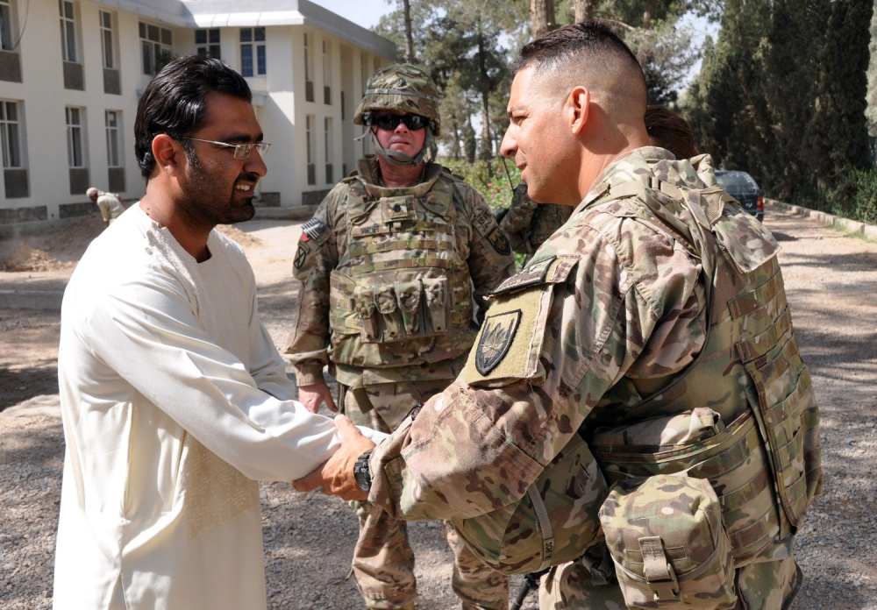
Intro
Key Leader Engagement: working to build relationships with higher officials
Why Virtual Human Toolkit?
Storytelling: oldest style of teaching lessons ⁵
Technology helps
Train as you fight → soldiers need to be tactically proficient
Ability to train 24/7 in any scenario

Slide 4
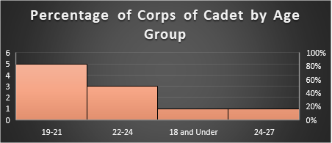
Front End Analysis
Used mainly to provide a comprehensive view of the personas used within Key Leader Engagements² (KLEs)
Comprehensive map³ composed of:
Problem Analysis
Environmental Analysis
Functional and Task Analysis
ie. Cadets’ engagements with the USMA Arms Room
Notes:
Center of Army Lessons Learned
Security Force advise and assist missions
Commander’s handbook for strategic communication and communication strategy → help us to frame the context of the KLEs and the purpose
Us:
Trying to step into the problem and work with a culture that we know well in order to figure the avatar
By doing it with known cultures and validating processes, this helps us to apply the process to more diverse issues or scenarios
Explain example of the Arms Room → not one overall end state like videogames, etc. (mainly to get them reps on engaging)
Aim is to build a comprehensive map, as suggested by Tolman, rather than just redundant activity like rifle marksmanship with one defined answer
Story should be structured in part/whole relationships, not like that of a strip map, which is disjointed, and often an overdosed and overtrained path
Helps to generate awareness, pick up cues, and get them to other interactions within the corps
Next semester will be focused around engagements that we are less versed in, with application to Army operations and the current battlefield that we may find ourselves in for training purposes

Slide 5
Thurstone Scaling
Characteristic Validation
Used to identify important traits and mannerisms for the virtual human.
Gathered perceptions of training population on KLE subject. (32 respondents)
Cross validated responses with 7-point Likert scale from test population. (54 respondents)
Identified points of unity for creation of virtual human and potential training points
Question: Q-Score
Q2-5 “Disrespectful 1.85
Q2-6 “Generally friendly” 1.58
Q2-7 “Look like a bro-vet” 1.61
Q2-8 “Friendlier if you show interest” 1.46

Slide 6
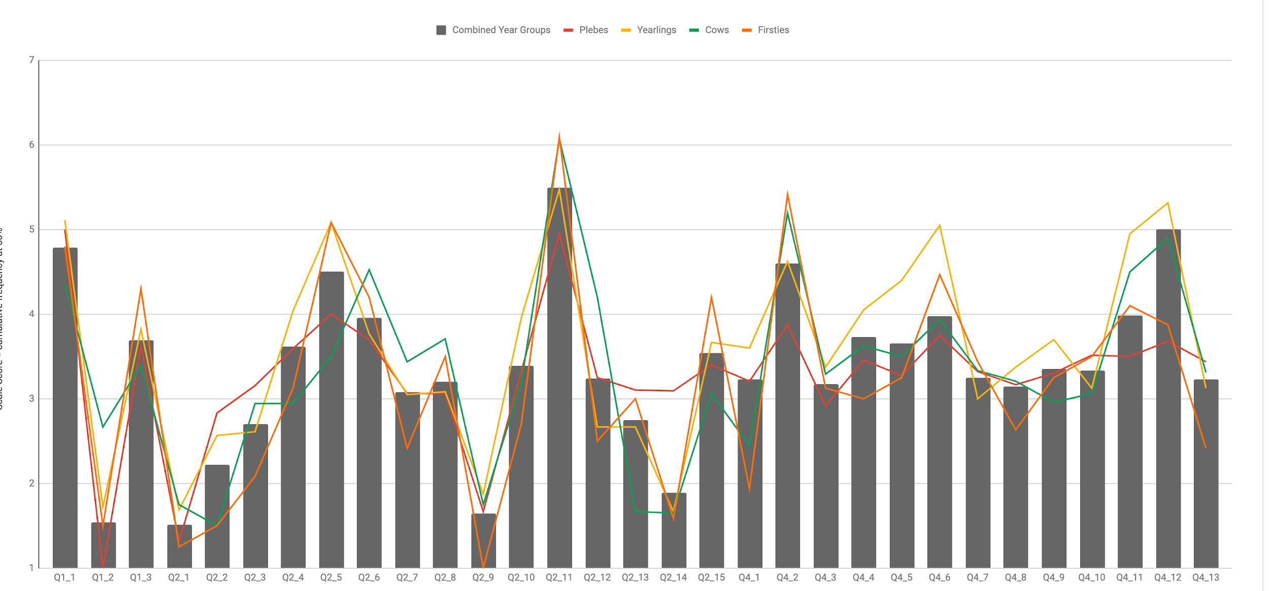
Comparison of Question Responses by Class vs Aggregate
Least Agreeable
Most Agreeable
4.
Questions: Section_Number

Slide 7
Thurstone Conclusions
Q2-14 “They are harsh on those cadets who don't follow instructions/read the posted rules.”
Q2-9 “They are protective of the weapons and equipment”
Q4-4 “They act as part of a boy’s club and exclude others
Cow class (Juniors) consistently had the largest deviation from the mean
Shows a consistent agreement across all cadet classes except for Plebes (Freshmen).
Shows a large discrepancy between Firstie class (Seniors) and other classes
No agreement, would be removed from virtual human characteristics
What factors in the Cow class experience might account for this?

Slide 8
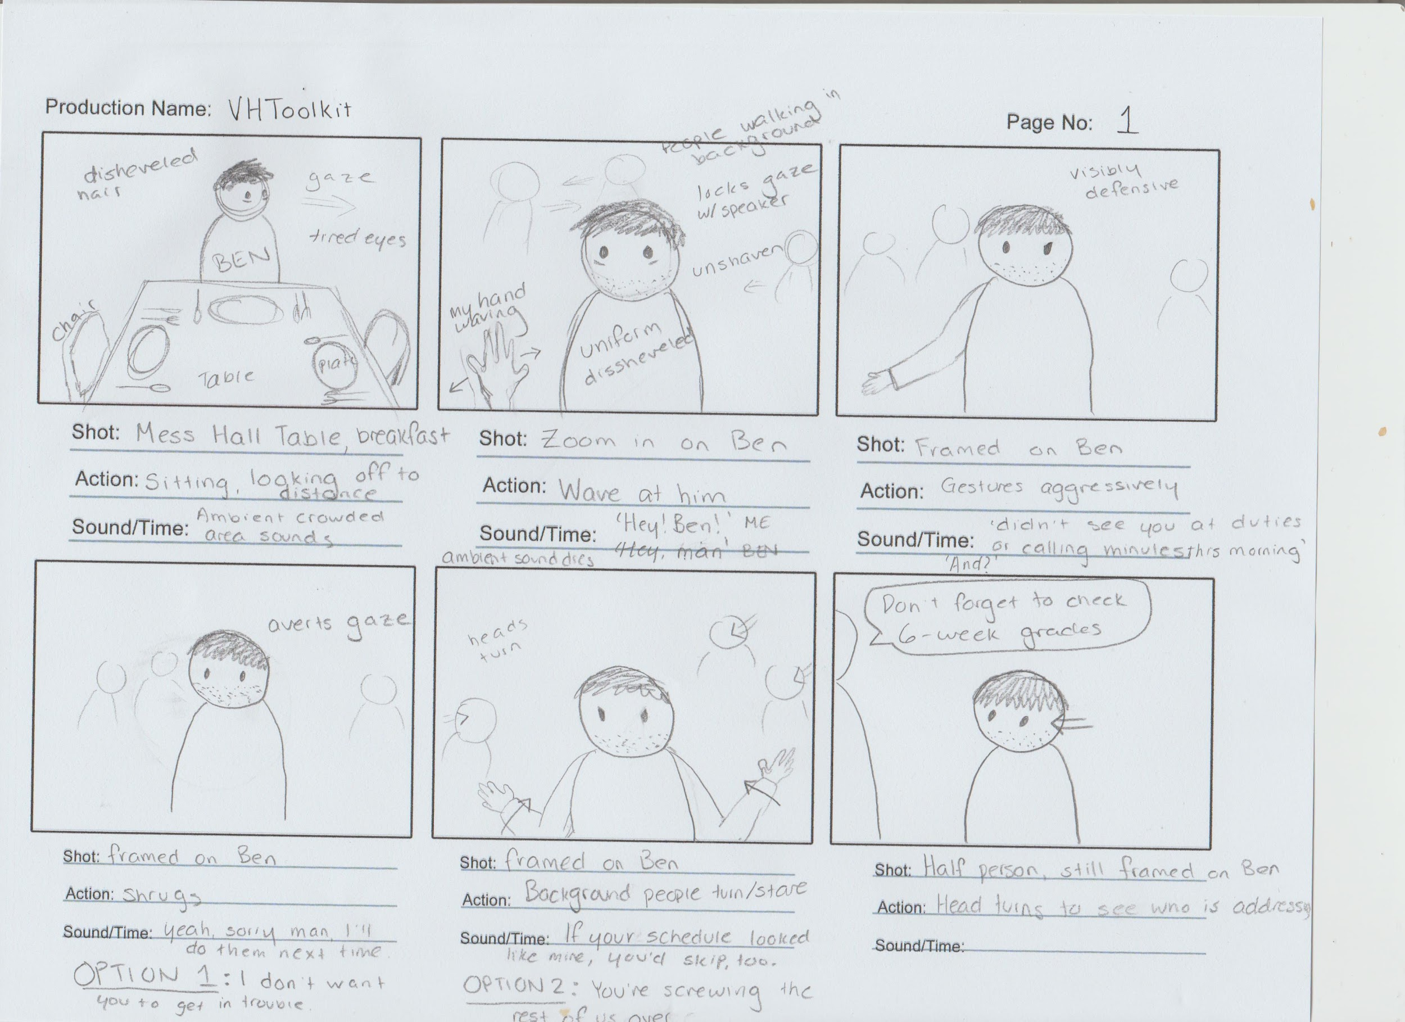
Storyboard
(2019). How to draw A-grade storyboards (even if you can’t draw!) | Media studies tutorial. [Film]. The Media Insider.

Slide 9
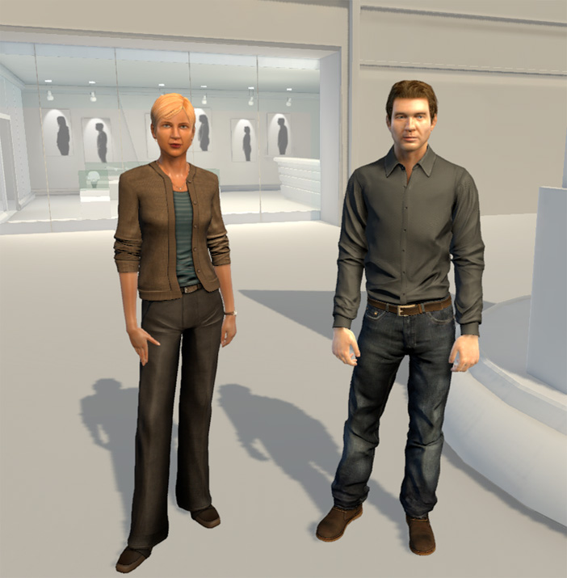
Virtual Human Toolkit
Help train interpersonal skills for young/inexperienced officers.
Code responses, facial expression, body language, speech, tone, etc.
Voice recognition
Identifies: relevant answers, words
Answers appropriately
Relates to storyboard to think through responses and behavior when interacting with the Virtual Human

Slide 10
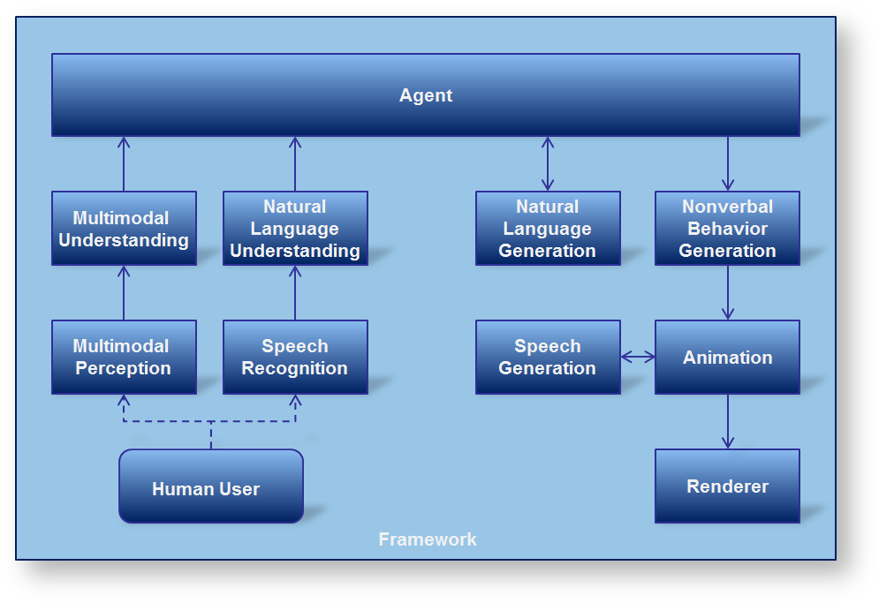
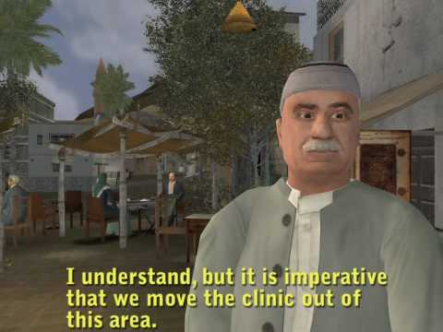
Virtual Human Toolkit

Slide 11
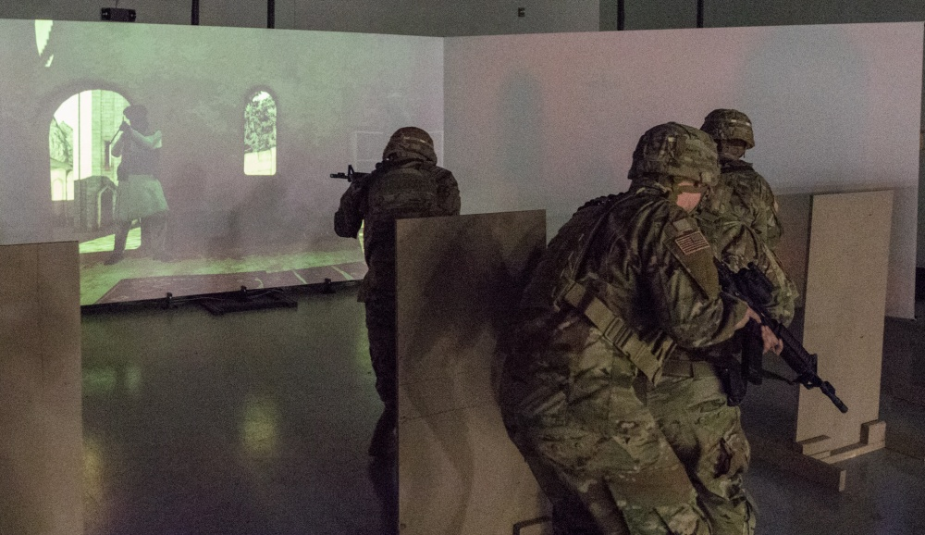
Outro
So What?
Get the reps before the real KLE situation
These simulations are critical to our development as leaders amid a crisis such as the pandemic we are facing
We have to be able to adapt and train despite adverse circumstances

Slide 12
Questions:
Example Questions/discussion?

Slide 13
Sources
Gratch, J., Hartholt, A., Dehghani, M., & Marsella, S. (2013). Virtual Humans: A New Toolkit for Cognitive Science Research. Proceedings of the Annual Meeting of the Cognitive Science Society, 35. Retrieved from https://escholarship.org/uc/item/9j9404c3
Command, U. J. F. (2010). Commander’s handbook for strategic communication and communication strategy. Version, 3, 24.
Tolman, E. (1948) Cognitive maps in rats and men, The Psychological Review, 55(4), 189-208.
The data analysis for this paper was generated using Qualtrics software, Version XM of Qualtrics. Copyright © 2018 Qualtrics. Qualtrics and all other Qualtrics product or service names are registered trademarks or trademarks of Qualtrics, Provo, UT, USA. https://www.qualtrics.com
Ness, J., DiNinni, R., Kim, J., Campbell, J., Castenada, R., Vigil, J., & Bennett, A. (2015). Cognitive Cartography: The Advisor Self-directed Immersive Readiness Tool. https://asirt.ict.usc.edu/
(2019). How to draw A-grade storyboards (even if you can’t draw!) | Media studies tutorial. [Film]. The Media Insider.

